Slide 1
Chapter 2: Chapter 2: Current evidence for the role of IUS in the continuum of care for IBD
v1.0, 10 December 2022 | EM-121011
For Healthcare Professionals only
Developed under the mentorship of the Asian Organization for Crohn's & Colitis
Supported by Janssen Asia Pacific, a division of Johnson and Johnson International (Singapore) Pte. Ltd. Editorial development by Transform Medical Communications, New Zealand
© Janssen Asia Pacific, a division of Johnson & Johnson International (Singapore) Pte. Ltd.

Slide 2
About IUS Primer module
IUS Primer module was created for training gastroenterologists in Asia on adopting Intestinal Ultrasound (IUS) for the diagnosis and management of Inflammatory Bowel Disease
Transform Medical Communications was commissioned by Janssen Asia Pacific for the development of this educational module under the guidance of IUS Primer working group members and AOCC. The division of Janssen responsible for developing the module is from medical education that follows strict non-promotional and educational guidance.
The development of the module was funded by Janssen Asia Pacific, a division of Johnson and Johnson International (Singapore) Pte. Ltd. in 2022. Non-commercial use of this module is permitted without any further permission, provided credit for the content is clearly attributed to Janssen Asia Pacific.
AOCC: Asian Organization for Crohn's & Colitis; IUS: Intestinal ultrasound.

Slide 3
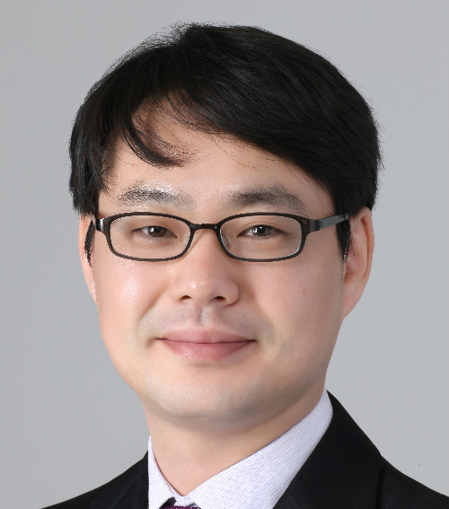
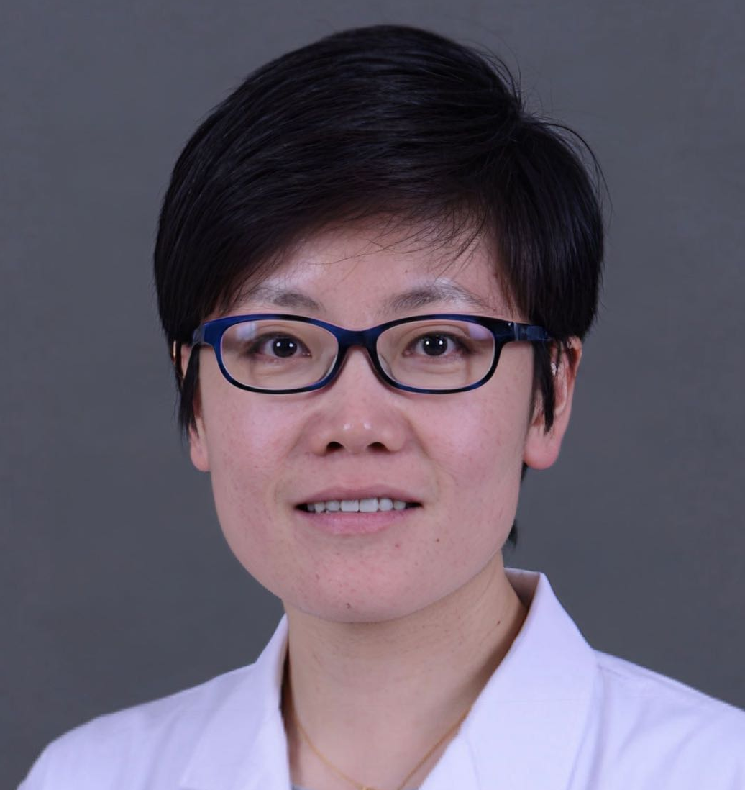
Special thanks to IUS Primer AOCC working group members
Prof. Eun Soo KIM
A/Prof. Ren MAO
Kyungpook National University
First Affiliated Hospital of Sun Yat-sen University
KOREA
CHINA
Prof. Chang Kyun LEE
A/Prof. Jun MIYOSHI
Kyung Hee University
Kyorin University
KOREA
JAPAN
Prof. Yue LI
Dr. Shintaro SAGAMI
Peking Union Medical College Hospital
Kitasato University Kitasato Institute Hospital
CHINA
JAPAN
AOCC: Asian Organization for Crohn's & Colitis; IUS: Intestinal ultrasound; WG: working group.

Slide 4
Learning Objectives
Explore the clinical applications of IUS in the diagnosis and treatment of IBD
Discuss the key studies using IUS and the correlations of IUS criteria with accepted markers of disease in IBD
1
2

Slide 5
Introduction
T2T strategy is currently recommended for the management of patients with CD ¹ and UC.^{1,2}
Transmural and mucosa healing are important targets to follow in order to determine the optimal therapeutic strategy.^{1.2}
A thorough evaluation of intestinal healing however remains a key issue.¹
IUS has emerged as a useful and objective modality for the diagnosis and monitoring response to treatment for patients with CD and UC.¹
T2T: treat to target; CD: Chron’s disease; UC: ulcerative colitis.
1. Helwig, U. (2022). J Crohns Colitis. 16(1):57-67. 2. Danese, S. (2022). Lancet Gastroenterol Hepatol. 7(4):294-306.
Notes:
Helwig, U., Fischer, I., Hammer, L., Kolterer, S., Rath, S., Maaser, C., & Kucharzik, T. (2022). Transmural Response and Transmural Healing Defined by Intestinal Ultrasound: New Potential Therapeutic Targets?. Journal of Crohn's & colitis, 16(1), 57–67. https://doi.org/10.1093/ecco-jcc/jjab106.
Danese, S., Vermeire, S., D'Haens, G., Panés, J., Dignass, A., Magro, F., Nazar, M., Le Bars, M., Lahaye, M., Ni, L., Bravata, I., Lavie, F., Daperno, M., Lukáš, M., Armuzzi, A., Löwenberg, M., Gaya, D. R., Peyrin-Biroulet, L., & STARDUST study group (2022). Treat to target versus standard of care for patients with Crohn's disease treated with ustekinumab (STARDUST): an open-label, multicentre, randomised phase 3b trial. The lancet. Gastroenterology & hepatology, 7(4), 294–306. https://doi.org/10.1016/S2468-1253(21)00474-X

Slide 6
Summary of key IBD trials adopting an IUS-related treatment end-point
Trial | Role of IUS | Conclusion
METRIC study¹ | Diagnostic accuracy of MRI vs IUS in SBCD and colonic CD | Both tests have a variable interobserver agreement and are similar in diagnostic impact and cost-effectiveness. MRI has higher accuracy for detecting the presence, extent and activity of small bowel CD than IUS.
TRUST study² | Use of IUS for monitoring of response to treatment in CD | Patients responding to treatment showed significant improvements in most IUS parameters. IUS is a good follow-up method to evaluate early transmural changes in disease activity, in response to medical treatment.
TRUST&UC study³ | Use of IUS for monitoring of response to treatment in UC | Monitoring BWT alone with IUS can predict therapeutic response and can be used in general practice in a point-of-care setting for assessing short-term treatment response
TRUST and TRUST&UC post-hoc analysis⁴ | Monitoring with IUS to assess TR and TH | IUS is a useful method to assess transmural inflammatory activity in clinical practice. TR and TH are predictive for sonographic outcome at week 52.
STARDUST-IUS sub study⁵ | To assess IUS parameters in response to ustekinumab treatment | Normalization of IUS-measured BWT, doppler signal, inflammatory fat, and stratification was detected starting at week 8. IUS can be a valuable tool to detect early response to treatment in CD.
IBD: inflammatory bowel disease; MRI: magnetic resonance imaging; IUS: intestinal ultrasound; CD: Crohn’s disease; SBCD: small bowel Crohn’s disease.; UC, ulcerative colitis; TR, transmural response; TH, transmural healing; BWT, bowel wall thickness
1. Taylor, S. A. (2019). Health technology assessment (Winchester, England). 23(42), 1–162. 2. Kucharzik, T. (2017). Clinical gastroenterology. 15(4), 535–542.e2. 3. Maaser, C. (2020). Gut. 69(9), 1629–1636. 4. Helwig, U. (2022). J Crohns Colitis. 16(1):57-67. 5. Danese, S. (2022). Lancet Gastroenterol Hepatol. 7(4):294-306

Slide 7
METRIC study for diagnostic accuracy of IUS vs MRI
Study details
A multicenter, non-randomized, single-arm, prospective study comparing the diagnostic accuracy of MRI vs. IUS. 284 adult patients with either newly diagnosed CD or in relapse were followed for 6 months with MRI and IUS.
 | Primary outcome: SBCD extent |  | SBCD presence |  | Colonic CD extent |  | Colonic CD presence
 | Sensitivity | Specificity | Sensitivity | Specificity | Sensitivity | Specificity | Sensitivity | Specificity
MRI | 80% | 95% | 97% | 96% | 22% | 93% | 64% | 96%
IUS | 70% | 81% | 92% | 84% | 17% | 93% | 73% | 96%
Difference | 10% (p=0.027) | 14% (p=0.039) | 5% | 12% | 5% | 0% | -9% | 0%
IUS showed on average, an accuracy of 70% sensitivity in detecting the presence of SBCD with 90% specificity.
When compared to colonoscopy standards, the difference in sensitivities of MRI (97%) and IUS (91%) were not statistically significant.
IUS-based therapeutic decisions agreed with panel decisions in 70% of the cases compared to 78% for MRI
IUS is an acceptable approach for patients: 99% of participants rated IUS as very or fairly acceptable compared to 88% for MRI
Both tests have a variable interobserver agreement and are similar in diagnostic impact and cost-effectiveness.
MRI has higher accuracy for detecting the presence, extent and activity of small bowel CD than IUS.
KEY STUDY CONCLUSIONS
(IUS vs MRI)
MRI: magnetic resonance imaging; IUS: intestinal ultrasound; CD: Crohn’s disease; SBCD: small bowel Crohn’s disease.
Taylor, S. A. (2019). Health technology assessment (Winchester, England). 23(42), 1–162.
Notes:
Taylor, S. A., Mallett, S., Bhatnagar, G., Morris, S., Quinn, L., Tomini, F., Miles, A., Baldwin-Cleland, R., Bloom, S., Gupta, A., Hamlin, P. J., Hart, A. L., Higginson, A., Jacobs, I., McCartney, S., Murray, C. D., Plumb, A. A., Pollok, R. C., Rodriguez-Justo, M., Shabir, Z., … Halligan, S. (2019). Magnetic resonance enterography compared with ultrasonography in newly diagnosed and relapsing Crohn's disease patients: the METRIC diagnostic accuracy study. Health technology assessment (Winchester, England), 23(42), 1–162. https://doi.org/10.3310/hta23420

Slide 8
Comparative accuracy of IUS vs MRE + colonoscopy
Study details
A consecutive, prospective study in a tertiary Italian IBD center, including 60 patients with ileal and/or colonic CD, followed up for 1 week.
Accuracy of IUS
 | Localisation | Disease activity | Strictures | Fistulas | Abscess
Sensitivity | 88% | 92% | 75% | 100% | 100%
Specificity | 96% | 100% | 86% | 98% | 96%
Accuracy | 91% | 96% | 81% | 98% | 96%
PPV | 96% | 100% | 78% | 66% | 33%
NPV | 85% | 94% | 83% | 100% | 100%
IUS is very accurate in assessing ileocolonic CD.
Non-invasive, easy-to-use tool in clinical practice
Concordance between IUS and MRE in the management of CD patients was 0.800 (p<0.001)
KEY STUDY CONCLUSIONS
IBD, inflammatory bowel disease; IUS, intestinal ultrasound, CD, Crohn’s disease; MRE, magnetic resonance enterography, PPV, positive predictive value; NPV, negative predictive value
Allocca, M., et al. (2018). Journal of Crohn's and Colitis, 12(11), 1280-1287.
Notes:
Allocca, M., et al. (2018). Journal of Crohn's and Colitis, 12(11), 1280-1287.

Slide 9
TRUST study – IUS for monitoring response to treatment in CD
OVERVIEW
Prospective non-interventional multicenter study conducted in 47 German centers to evaluate whether IUS can be used for disease monitoring of patients with CD. 234 CD patients 18 or older, with bowel wall alterations within the terminal ileum and/or segments of the colon who experienced a flare (HBI score of ≥ 7) were monitored for 12 months with IUS and received standard care (corticosteroids, conventional immunosuppressives, and/or anti-tumour necrosis factor antagonists).
Proportion of patients with corresponding ultrasound signal over the study period (n= 134)
P < .003 for all visits versus baseline
KEY RESULTS FOR IUS PARAMETERS
Patients responding to treatment showed significant improvements in most IUS parameters, including:
Normalization of BWT
Bowel wall stratification
Fibrofatty proliferation and Increased signals in color Doppler ultrasound
Concurrent with the changes in the IUS parameters’, changes in clinical HBI score, and CRP were observed.
There was a strong correlation between BWT and CRP levels.
IUS is a good follow-up method to evaluate early transmural changes in disease activity, in response to medical treatment.
TRUST: Transabdominal Ultrasonography of the bowel in subjects with IBD To monitor disease activity; IUS: intestinal ultrasound; CD: Crohn’s disease; HBI: Harvey-Bradshaw index; BWT: bowel wall thickness; CRP: C-reactive protein
Kucharzik, T. (2017). Clinical gastroenterology. 15(4), 535–542.e2.
Notes:
Kucharzik, T., Wittig, B. M., Helwig, U., Börner, N., Rössler, A., Rath, S., Maaser, C., & TRUST study group (2017). Use of Intestinal Ultrasound to Monitor Crohn's Disease Activity. Clinical gastroenterology and hepatology : the official clinical practice journal of the American Gastroenterological Association, 15(4), 535–542.e2. https://doi.org/10.1016/j.cgh.2016.10.040

Slide 10
TRUST&UC study - IUS for monitoring response to treatment in UC
Study details
Prospective observational evaluation of IUS for disease monitoring of patients with UC in routine clinical practice. The study was conducted in 42 German IBD-specialized centres with 224 patients who received standard-of-care treatment (aminosalicylates, corticosteroids, conventional immunosuppressives, and/or biologics) and were monitored with IUS for 12 weeks.
Proportion of patients with increased BWT over the study period*
Patients (%)
P<0.001
P<0.001
Patients responding to treatment had lower BWT at weeks 2, 6, and 12 compared to baseline.
The study found a correlation between BTW normalization and clinical response.
Rapid improvement of the IUS pathology was observed as early as 2 weeks after treatment intensification, followed by clinical improvement as determined by Short Clinical Colitis Activity Index.
The study found a correlation between BTW and FC
Monitoring BWT alone with IUS can predict therapeutic response and can be used in general practice in a point-of-care setting for assessing short-term treatment response
KEY RESULTS FOR IUS PARAMETERS
* Approximate values used to create the graph as raw data are not available
TRUST&UC: Transabdominal Ultrasonography of the bowel in subjects with IBD To monitor disease activity with UC; UC: ulcerative colitis; IUS: intestinal ultrasound; IBD: inflammatory bowel disease; BWT: bowel wall thickness; FC: faecal calprotectin
Maaser, C. (2020). Gut. 69(9), 1629–1636.
Notes:
Maaser, C., Petersen, F., Helwig, U., Fischer, I., Roessler, A., Rath, S., Lang, D., Kucharzik, T., German IBD Study Group and the TRUST&UC study group, & German IBD Study Group and TRUST&UC study group (2020). Intestinal ultrasound for monitoring therapeutic response in patients with ulcerative colitis: results from the TRUST&UC study. Gut, 69(9), 1629–1636. https://doi.org/10.1136/gutjnl-2019-319451

Slide 11
Post-hoc analysis of TRUST and TRUST&UC studies
Study details
Post-hoc analysis of TRUST and TRUST&UC studies to assess TH as a target using IUS in 135 IBD patients with increased BWT. Patients were monitored with IUS to assess TR (>25% reduction of BWT) and TH (different levels based on BWT normalization, color doppler normalization, no loss of stratification, no fibro-fatty proliferation, with complete TH if the four criteria are met).
66% of CD and 77% of UC patients showed TR at 12 weeks.
23% of patients with CD and 45% of patients with UC showed complete TH at 12 weeks.
89% of patients with CD who showed TR at 12 weeks also showed TR at 52 weeks.
93% and 79% of patients with TR at 12 weeks showed clinical response and clinical remission at 52 weeks.
IUS is a useful method to assess transmural inflammatory activity in clinical practice. TR and TH are predictive for sonographic outcome at week 52.
KEY RESULTS USING IUS MONITORING
TRUST: Transabdominal Ultrasonography of the bowel in subjects with IBD To monitor disease activity; TRUST&UC: Transabdominal Ultrasonography of the bowel in subjects with IBD To monitor disease activity with UC; UC: ulcerative colitis; CD: Chron’s disease; TR: transmural response; TH: transmural healing; IUS: intestinal ultrasound; BTW: bowel wall thickness; CRP: C-reactive protein; FC: fecal calprotectin; HBI: Harvey-Bradshaw index.
Helwig, U. (2022). J Crohns Colitis. 16(1):57-67.
Notes:
Helwig, U., Fischer, I., Hammer, L., Kolterer, S., Rath, S., Maaser, C., & Kucharzik, T. (2022). Transmural Response and Transmural Healing Defined by Intestinal Ultrasound: New Potential Therapeutic Targets?. Journal of Crohn's & colitis, 16(1), 57–67. https://doi.org/10.1093/ecco-jcc/jjab106.

Slide 12
STARDUST-IUS sub-study for monitoring response to ustekinumab treatment in CD
Study details
An open-label, multicenter, randomized phase 3b study,¹ comparing the effects of T2T maintenance treatment vs. standard of care.^{1,2} The goal of the sub-study was to assess the IUS parameters in response to ustekinumab treatment.² The study included 498 patients with moderate to severe CD activity (CDAI 220-450 & SES-CD ≥ 3) who failed conventional treatment and/or biologic.² Patients received IV UST 6mg/kg at week 0, then SC 90 mg at week 8. At week 16, patients with a CDAI reduction of ≥ 70 (n=440) were randomized (1:1) to T2T or standard of care arms.² IUS parameters were recorded at 4, 8 and 16 weeks during the trial.
 | Week 4 | Week 8 | Week 16
IUS response (TR)² | 26.7% | 26.1% | 33.8%
IUS remission (TH)² | 1.7% | 5.8% | 11.3%
IUS response is defined as a reduction of ≥25% from baseline in BWT. IUS remission (TH) is defined as normalization of BWT, vascularization (colour Doppler signal), echo stratification and inflammatory mesenteric fat. ²
TR at week 16 was observed in 33.8% while TH was observed in 11% of patients.
Normalization of IUS-measured BWT, doppler signal, inflammatory fat, and stratification was detected starting at week 8.
Statistically significant changes in BWT were detected at week 4 for the ileum and week 8 for the colon.
IUS can be a valuable tool to detect early response to treatment in CD.²
Key results using IUS monitoring²
CD: Crohn’s disease; CDAI: Crohn’s disease activity index; SES-CD: simple endoscopic index for CD; IV: intravenous; UST: Ustekinumab; SC: subcutaneous; TR: transmural response; TH: transmural healing.
1. Danese, S. (2022). Lancet Gastroenterol Hepatol. 7(4):294-306. 2. Kucharzik, T. (2020). Z Gastroenterol. 58(05): e77.
Notes:
1. Danese, S., Vermeire, S., D'Haens, G., Panés, J., Dignass, A., Magro, F., Nazar, M., Le Bars, M., Lahaye, M., Ni, L., Bravata, I., Lavie, F., Daperno, M., Lukáš, M., Armuzzi, A., Löwenberg, M., Gaya, D. R., Peyrin-Biroulet, L., & STARDUST study group (2022). Treat to target versus standard of care for patients with Crohn's disease treated with ustekinumab (STARDUST): an open-label, multicentre, randomised phase 3b trial. The lancet. Gastroenterology & hepatology, 7(4), 294–306. https://doi.org/10.1016/S2468-1253(21)00474-X.
2. Kucharzik, T., Wilkens, R., Maconi, G., Agostino, M., Le Bars, M., Nazar, M., Sloan, S., Lahaye, M., Li, N., Ercole, E., Angela, A., Machkova N., Maaser, C. (2020). Intestinal ultrasound response and transmural healing after ustekinumab induction in Crohn’s disease: Week 16 interim analysis of the STARDUST trial substudy. Z Gastroenterol 2020; 58(05): e77. DOI: 10.1055/s-0040-1712250

Slide 13
Real-time assessment of disease activity and complications with IUS: a case study
Patient case:
A 25-year-old patient with ileal CD with acute steroid-refractory flare, abdominal cramping, and increased bowel frequency.
Response to treatment:
The patient shows early TH in response to treatment (anti-TNF).
Complication of CD:
The patient in clinical remission presents with acute pain. A perineal abscess was detected using transperineal ultrasound.
Treatment monitoring with IUS
Early IUS examination as recommended by ECCO-ESGAR can identify responders and allow early therapy adjustment.
Baseline
3 months
6 months
IUS and advanced ultrasound modalities are suitable for real-time and direct assessment of disease activity and complications.
IUS: intestinal ultrasound; CD: Crohn’s disease; ECCO: European Crohn’s and Colitis Organization; ESGAR European Society of Gastrointestinal and Abdominal Radiology; TH: transmural healing; TNF: tumor necrosis factor.
Maaser, M. (2022). United European gastroenterology journal, 10(2), 225–232.
Notes:
Maaser, M., Maconi, Kucharzik, T., & Mariangela, A. (2022). Ultrasonography in inflammatory bowel disease - So far we are?. United European gastroenterology journal, 10(2), 225–232. https://doi.org/10.1002/ueg2.12196

Slide 14
Reliability of IUS for monitoring disease activity in CD
Study details
A multicentre prospective longitudinal study in Spain enrolled 51 patients with Crohn’s disease to assess the long-term effect of biological treatment on transmural lesions of Crohn’s disease evaluated with IUS. Patients underwent clinical and sonographic assessment at baseline, 12 weeks and one year of treatment initiation.
Sonographic changes | At 12 weeks (%) | At 52 weeks
Normalization | 14% | 29.5%
Improvement | 37% | 27.5%
No improvement | 41% | 31%
Worsening | 8% | 12%
Clinical response at 52 weeks | IUS response at 52 weeks
 | TH or Improvement | Lack of response
Remission | 27 | 9
Partial response | 1 | 5
Lack of response | 1 | 8
Patients who show IUS improvement at 12 weeks have greater chances of showing improvement after 52 weeks of treatment
Key results using IUS monitoring²
Assessment of short-term treatment response (week 12) with IUS is a good predictor of IUS response at 52 weeks.
Good sonographic response at 52 weeks predicts good long-term clinical outcomes at 2-3 years with sensitivity and specificity of 78% and 81%, respectively.
IUS: intestinal ultrasound; CD: Crohn’s disease.
Ripollés, T. (2016). Inflammatory bowel diseases. 22(10), 2465–2473
Notes:
Ripollés, T., Paredes, J. M., Martínez-Pérez, M. J., Rimola, J., Jauregui-Amezaga, A., Bouzas, R., Martin, G., & Moreno-Osset, E. (2016). Ultrasonographic Changes at 12 Weeks of Anti-TNF Drugs Predict 1-year Sonographic Response and Clinical Outcome in Crohn's Disease: A Multicenter Study. Inflammatory bowel diseases, 22(10), 2465–2473. https://doi.org/10.1097/MIB.0000000000000882

Slide 15
Adopting IUS for follow-up of patients with IBD
IUS is an authentic tool for following UC evolution after treatment.¹
IUS is an effective tool for monitoring response to treatment and disease activity in patients with active CD.²
TR and TH, as measured by IUS at 12 weeks, are good predictors for clinical remission at 52 weeks.^{3,4}
IUS is a useful tool to assess transmural inflammatory activity in daily clinical practice.³
IUS: intestinal ultrasound; UC: ulcerative colitis; CD: Crohn’s disease; TR: transmural response; TH: transmural healing.
1. Maaser, C. (2020). Gut. 69(9), 1629–1636. 2. Kucharzik, T. (2017). Clinical gastroenterology. 15(4), 535–542.e2. 3. Helwig, U. (2022). J Crohns Colitis. 16(1):57-67. 4. Ripollés, T. (2016). Inflammatory bowel diseases. 22(10), 2465–2473
Notes:
1. Maaser, C., Petersen, F., Helwig, U., Fischer, I., Roessler, A., Rath, S., Lang, D., Kucharzik, T., German IBD Study Group and the TRUST&UC study group, & German IBD Study Group and TRUST&UC study group (2020). Intestinal ultrasound for monitoring therapeutic response in patients with ulcerative colitis: results from the TRUST&UC study. Gut, 69(9), 1629–1636. https://doi.org/10.1136/gutjnl-2019-319451
2. Kucharzik, T., Wittig, B. M., Helwig, U., Börner, N., Rössler, A., Rath, S., Maaser, C., & TRUST study group (2017). Use of Intestinal Ultrasound to Monitor Crohn's Disease Activity. Clinical gastroenterology and hepatology : the official clinical practice journal of the American Gastroenterological Association, 15(4), 535–542.e2. https://doi.org/10.1016/j.cgh.2016.10.040
3. Helwig, U., Fischer, I., Hammer, L., Kolterer, S., Rath, S., Maaser, C., & Kucharzik, T. (2022). Transmural Response and Transmural Healing Defined by Intestinal Ultrasound: New Potential Therapeutic Targets?. Journal of Crohn's & colitis, 16(1), 57–67. https://doi.org/10.1093/ecco-jcc/jjab106.
4. Ripollés, T., Paredes, J. M., Martínez-Pérez, M. J., Rimola, J., Jauregui-Amezaga, A., Bouzas, R., Martin, G., & Moreno-Osset, E. (2016). Ultrasonographic Changes at 12 Weeks of Anti-TNF Drugs Predict 1-year Sonographic Response and Clinical Outcome in Crohn's Disease: A Multicenter Study. Inflammatory bowel diseases, 22(10), 2465–2473. https://doi.org/10.1097/MIB.0000000000000882

